Slide 1
How to solve a large sparse linear system
arising in groundwater and CFD problems
J. Erhel, team Sage, INRIA, Rennes, France
Joint work with
A. Beaudoin (U. Le Havre)
J.-R. de Dreuzy (Geosciences Rennes)
D. Nuentsa Wakam (team Sage)
G. Pichot (U. Le Havre, soon team Sage)
B. Poirriez (team Sage)
D. Tromeur-Dervout (U. Lyon)
Financial support from ANR-CIS (MICAS project)
and from ANR-RNTL (LIBRAERO project)

Slide 2
Ax=b
with A non singular and sparse
Bad idea: compute A⁻¹ then x=A⁻¹ b
Good idea: apply a direct or iterative solver

Slide 3
First case
A symmetric positive definite (spd)
First example: flow in heterogeneous porous media
Second example: flow in 3D discrete fracture networks
Second case
A non symmetric
Example: Navier-Stokes with turbulence

Slide 4
H2OLab software platform
Random physical models
Porous Media
PARADIS
Fracture
Networks
MP_FRAC
Fractured-Porous Media
Utilitaries
GW_UTIL
Input / Output
Visualization
Results structures
Parameters structures
Parallel and grid tools
Geometry
Numerical methods
GW_NUM
Solvers
PDE solvers
ODE solvers
Linear solvers
Particle tracker
UQ methods
Monte-Carlo
Open source libraries
Boost, FFTW, CGal, Hypre, Sundials, MPI, OpenGL, Xerces-C,…

Slide 5
H2OLab methodology
Optimization and Efficiency
  Use of free numerical libraries and own libraries
  Test and comparison of numerical methods
  Parallel computation (distributed and grid computing)
Genericity and modularity
  Object-oriented programming (C++)
  Encapsulated objects and interface definitions
Maintenance and use
  Intensive testing and collection of benchmark tests
  Documentation : user’s guide, developer’s guide
  Database of results and web portal
Collaborative development
  Advanced Server (Gforge) with control of version (SVN),…
  Integrated development environments (Visual, Eclipse)
  Cross-platform software (Cmake, Ctest)
  Software registration and future free distribution

Slide 6
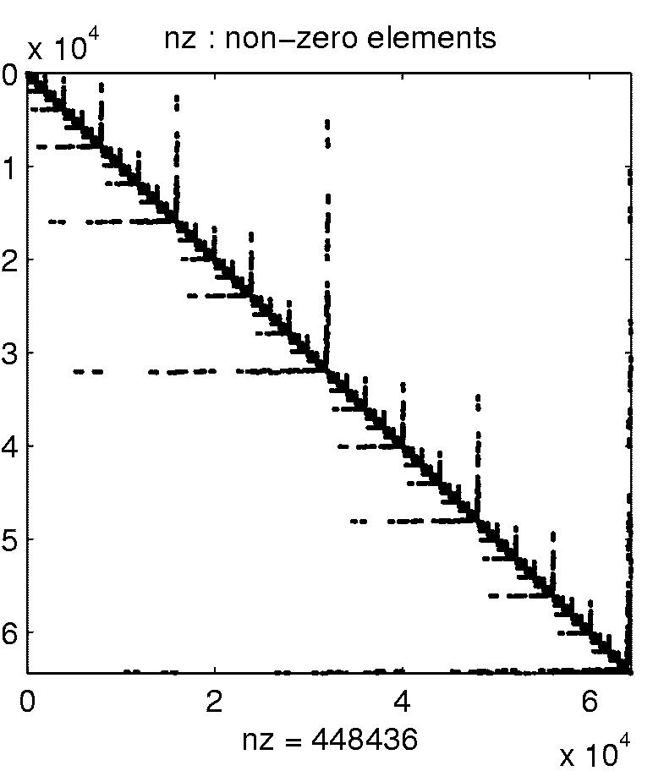
First case
A symmetric positive definite (spd)
arising from an elliptic or parabolic problem
Flow equations of a groundwater model
Q = - K*grad (h) in Ω
div (Q) = 0 in Ω
Boundary conditions on ∂Ω
Spatial discretization scheme
Finite element method
or finite volume method …
Ax=b, with A spd and sparse

Slide 7
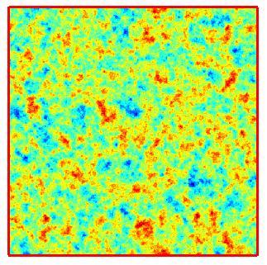
An example of domain and data
Heterogeneous porous media
Nul flux
2D Heterogeneous permeability field
Stochastic model Y = ln(K)
with correlation function
Fixed head
Fixed head
Nul flux

Slide 8
Numerical method for 2D heterogeneous porous medium
Finite Volume Method with a regular mesh
Large sparse structured matrix of order N with 5 entries per row

Slide 9
First solver for A spd and elliptic
Direct method based on Cholesy factorization
Cholesky factorization
A=LDL^{T}
with L lower triangular
and D diagonal
Based on elimination process
Fill-in in L
L sparse
but not as much as A
More memory and time
Due to fill-in

Slide 10
Fill-in in Cholesy factorization
depends on renumbering
Symmetric renumbering
PT A P = LDL^{T} with P permutation matrix
L full matrix
L as sparse as A: no fill-in

Slide 11
Analysis of fill-in with elimination tree
Matrix graph and interpretation of elimination
j connected to i1,i2 and i3 in the graph
Elimination tree
All steps of elimination in Cholesky algorithm

Slide 12
Sparse Cholesky factorization
Symbolic factorization
Build the elimination tree
Reduction of fill-in
Renumber the unknowns with matrix P
minimum degree algorithm
Nested dissection algorithm
Numerical factorization
Build the matrices L and D
Six variants of the nested three loops
Two column-oriented variants: left-looking and right-looking
Use of BLAS3 thanks to a multifrontal or supernodal technique

Slide 13
Sparse direct solver (here PSPASES)
applied to heterogeneous porous media
Fill-in
CPU time
Theory : NZ(L) = O(N logN)
Theory : Time = O(N^{1.5})

Slide 14
Sparse direct solver (here UMFPACK)
applied to heterogeneous porous media
CPU time
Condition number κ(A)

Slide 15
Second solver for A spd and elliptic
Iterative method based on Conjugate Gradient
Conjugate Gradient
Stop when residual is small
Convergence
Preconditioned Conjugate Gradient PCG

Slide 16
Preconditioned Conjugate Gradient
M must be also spd
Simple preconditioners
Splitting A=L+D+L^{T}; M= D or
Incomplete Cholesky preconditioners
A=LDL^{T} + R; M=LDL^{T}
IC(0): no fill-in in L; IC(k): level-k fill-in in L
Multigrid preconditioners
M defined by one V-cycle of AMG
Subdomain preconditioners
M defined by additive or multiplicative Schwarz method
Deflation and coarse-grid preconditioners
M defined by estimation of invariant subspaces

Slide 17
Preconditioned Conjugate Gradient (here within Matlab)
applied to heterogeneous porous media
P : ILU(0) preconditioner
Impact of σ
Impact of N=n²

Slide 18
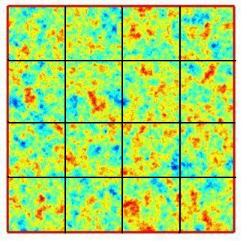
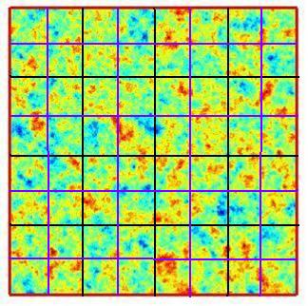
Third solver for A spd and elliptic
Iterative method based on geometric multigrid
Coarse grid
Fine grid
V cycles: solve on coarse grid, then fine grid, then coarse grid, etc
Several levels of grids

Slide 19
Geometric Multigrid (here HYPRE/SMG)
Applied to heterogeneous porous media

Slide 20
Geometric Multigrid (here HYPRE/SMG)
Applied to heterogeneous porous media

Slide 21
Direct and multigrid solvers
Parallel CPU times for various sizes
Grid’5000 cluster: 2 nodes of 32 dual-cores with 2 Go; Gigabit Ethernet
Cholesky is faster for small matrices and is more efficient with several processors
Multigrid is faster for large matrices and requires less memory

Slide 22
Fourth solver for A spd and elliptic
Iterative method based on algebraic multigrid
Algebraic MultiGrid AMG
Grid levels defined algebraically directly from the matrix
Algebraic definitions of transitions between levels
Designed for matrices with highly varying coefficients

Slide 23
Algebraic Multigrid (here HYPRE/AMG)
Applied to heterogeneous porous media
Comparison with SMG
AMG is not sensitive to σ and has a linear complexity
SMG is faster than AMG for small σ and slower for large σ

Slide 24
Linear solvers for heterogeneous porous media
Summary
Cholesky is more efficient for small matrices
Cholesky is scalable and is more efficient with many processors
SMG and AMG require less memory
SMG and AMG are more efficient for large matrices
SMG is faster than AMG for small σ and slower for large σ
Current work: 3D problems
domain decomposition methods
Schwarz method accelerated by Aitken

Slide 25
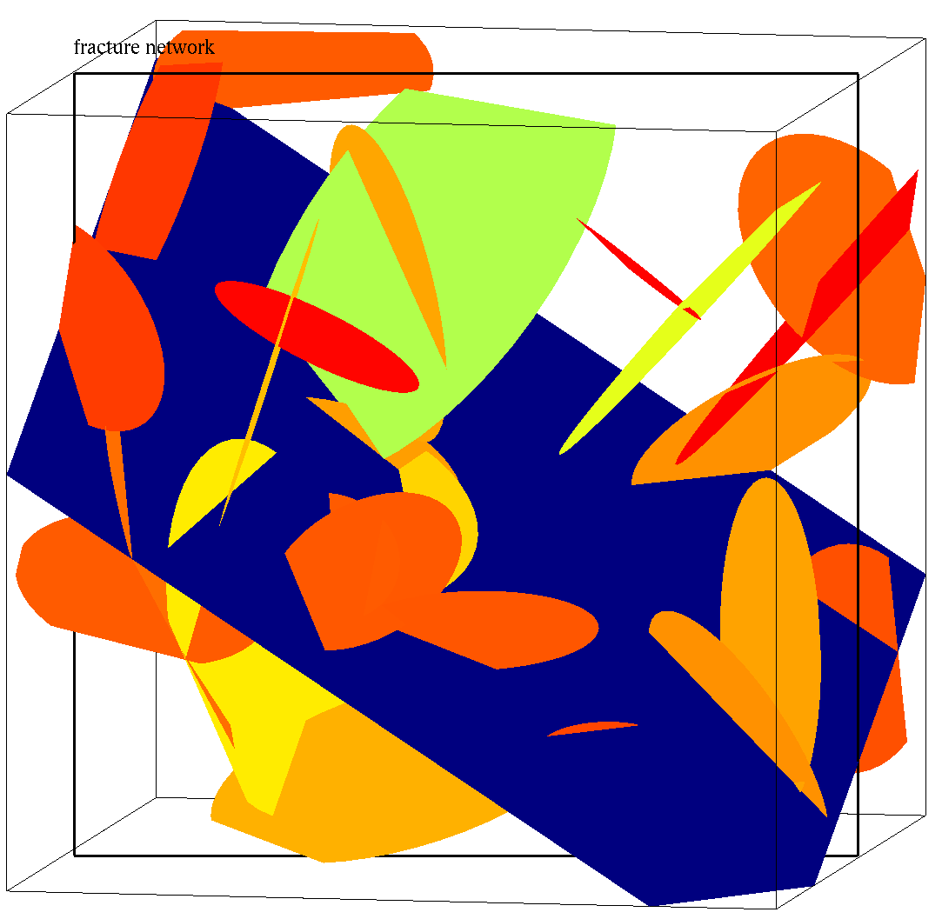
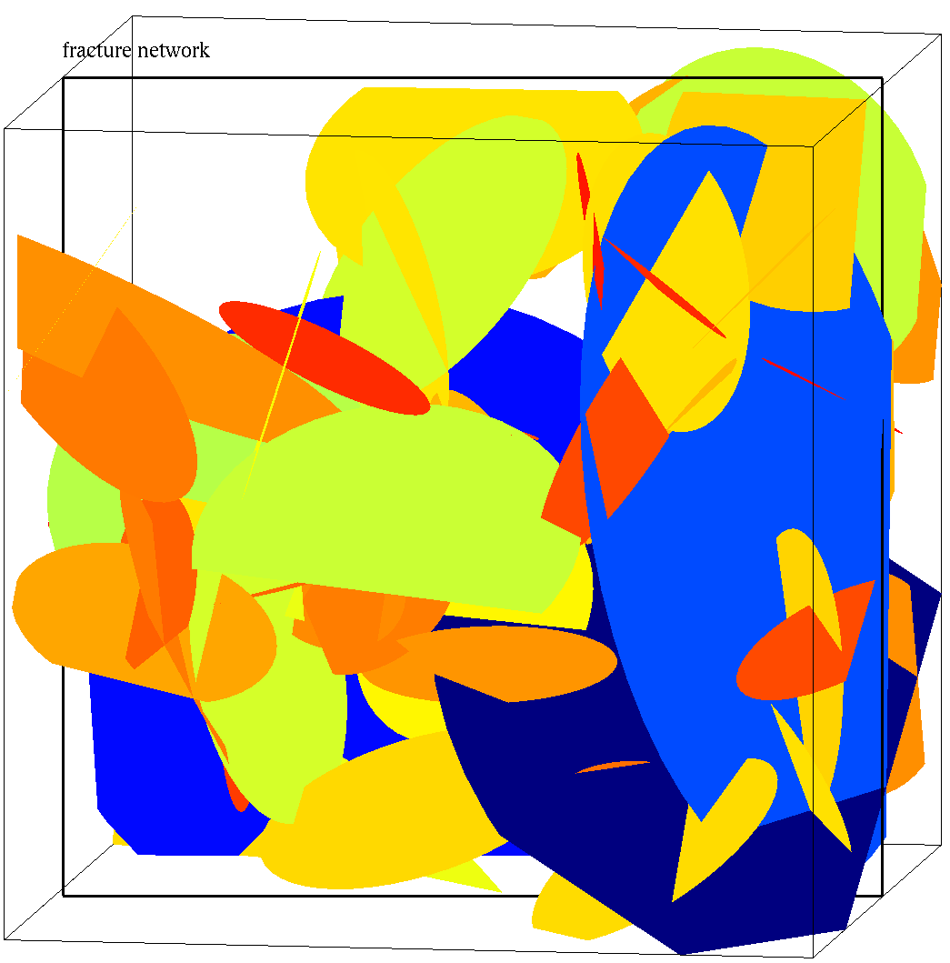
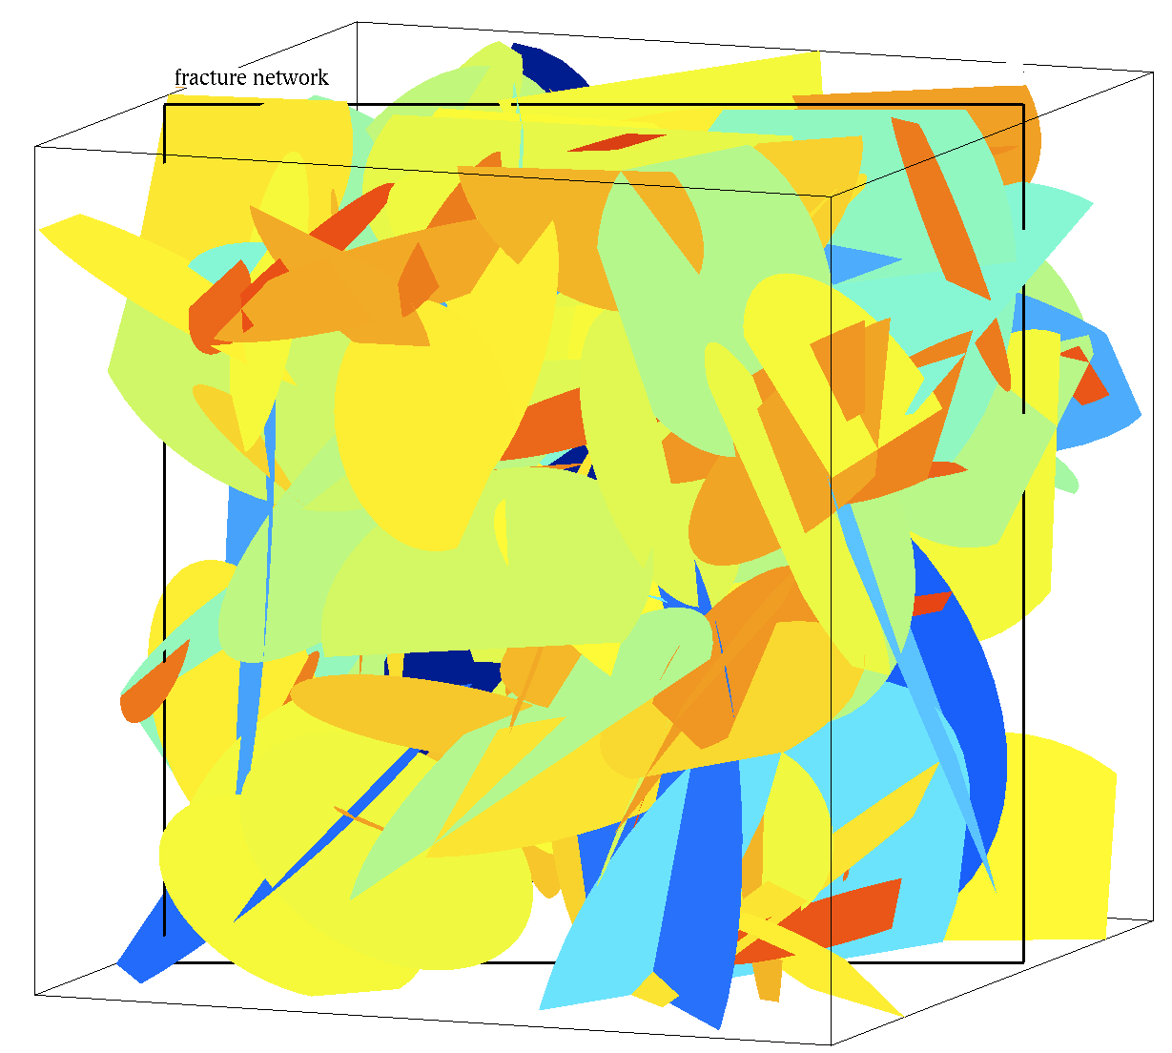
3D Discrete Fracture Networks: stochastic generation
a=2.5
a=3.5
a=4.5

Slide 26
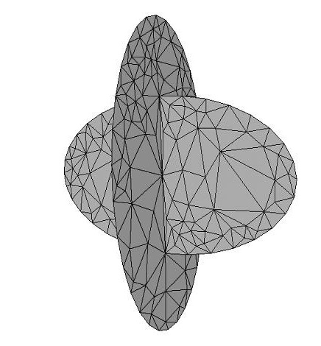
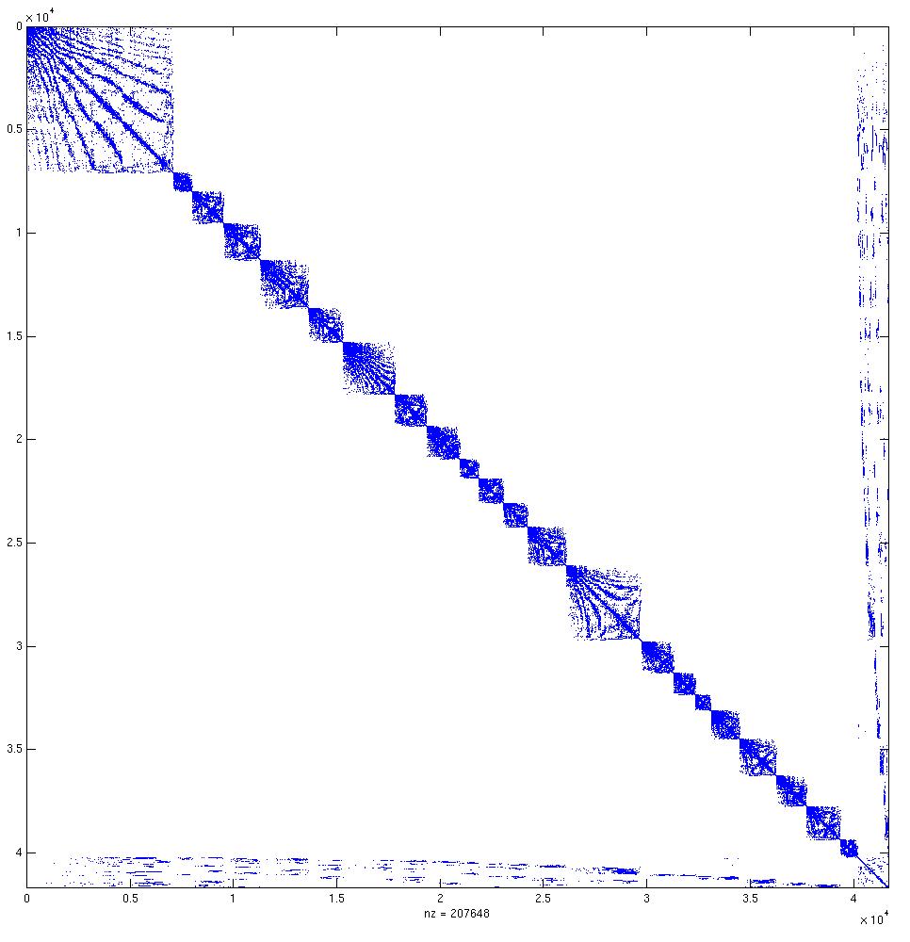
Linear solvers for Discrete Fracture Networks
Impervious rock matrix
Poiseuille’s law in each fracture
Continuity conditions at each intersection (hydraulic head and flux)
Specific mesh generation: 2D mesh in each fracture and
conforming or non conforming mesh at intersections

Slide 27
Linear solvers for Discrete Fracture Networks
Direct, Multigrid, PCG with P multigrid
Cholesky has a power complexity (with variable exponent)
AMG is fast but not reliable: missing red points are failures
PCG preconditioned by AMG is faster than Cholesy and reliable

Slide 28
Linear solvers for Discrete Fracture Networks
PCG with P multigrid
Refining the mesh
Increasing the density of fractures
Almost linear complexity but
the number of iterations slightly increases with the system size

Slide 29
Linear solvers for Discrete Fracture Networks
Summary
Cholesky is efficient for small matrices but has a power complexity
AMG may fail, for some unclear reason (up to now)
PCG with AMG is robust, but complexity is not linear
Current work: domain decomposition method
Schur method with Neumann-Neumann preconditioner
acceleration with coarse grid or deflation

Slide 30
Two-level parallelism
Parallel simulations
  Subdomain decomposition
  Parallel sparse linear solver for flux computation
  Parallel random walker for transport computation
  Programming model based on C++ and MPI
Parallel Monte-Carlo run
  Independent simulations
  Manage random number generation
  Programming model based on C++ and MPI

Slide 31
Parallel Monte-Carlo results
Cluster of nodes with a Myrinet network
Each node is one-core bi-processor, with 2Go memory
Monte-Carlo run of flow and transport simulations
Computational domain of size 1024x1024

Slide 32
Second case
A non symmetric
arising from an hyperbolic problem
Navier-Stokes equations in a CFD problem
Spatial discretization scheme: Finite element method
Ax=b, with A non symmetric
Matrix | N | NNZ | ORIGIN
CASE05 | 161,070 | 5,066,996 | 2D linear cascade turbine
CASE07 | 233,786 | 11,762,405 | 2D linear cascade compressor
CASE10 | 261,465 | 26,872,530 | 3D hydraulic gate case
CASE17 | 381,689 | 37,464,962 | 3D jet engine compressor

Slide 33
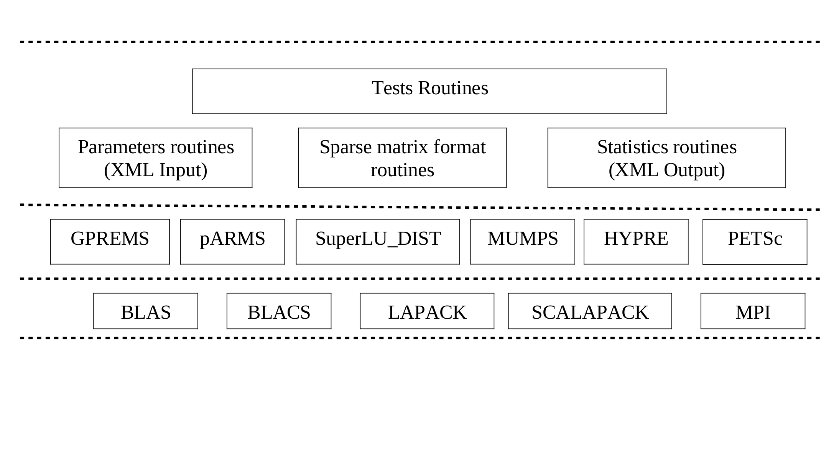
Software architecture for solving sparse linear solvers

Slide 34
First solver for A non symmetric
Direct method based on Gauss factorization
Gauss factorization
PA=LU
with L lower triangular and U upper triangular
and P permutation matrix
Based on elimination process
Fill-in in L and U
L and U sparse but not as much as A
Stability ensured by partial pivoting
Permutation of rows to get the largest pivot at each step

Slide 35
Sparse Gauss factorization
Symbolic factorization
Build the elimination tree
Reduction of fill-in
Renumber the unknowns with matrix P
minimum degree algorithm or nested dissection algorithm
Numerical factorization
Build the matrices L and U
Six variants of the nested three loops
Use of BLAS3 thanks to a multifrontal or supernodal technique
Numerical pivoting
Static pivoting chosen during symbolic factorization
Dynamic pivoting during numerical factorization

Slide 36
Sparse Gauss factorization
Applied to CFD problems
Results for matrix CASE17: time in seconds
Grid’5000 cluster: quadricore dual-CPU nodes Carri System with 32 GB memory
Solver | Ordering | P=4 | P=8 | P=16
SuperLU_DIST | METIS | 3923 | 2073 | 1098
MUMPS | METIS | 3598 | 2969 | 1960

Slide 37
Second solver for A non symmetric
Iterative method based on GMRES(m)
GMRES(m)
Convergence
Possible stagnation if A non normal or for small m
Preconditioned GMRES(m)
Apply GMRES(m) to M⁻¹ A or A M⁻¹

Slide 38
Preconditioned GMRES(m)
M must be non singular
Simple preconditioners
Splitting A=L+D+U; M= D or
Incomplete factorization preconditioners
A=LU + R; M=LU
ILU(0): no fill-in in L and U; ILU(k): level-k fill-in in L and U
Multigrid preconditioners
M defined by one V-cycle of AMG
Subdomain preconditioners
M defined by additive or multiplicative Schwarz method
Deflation and coarse-grid preconditioners
M defined by estimation of invariant subspaces

Slide 39
Preconditioned GMRES(m)
Applied to CFD problems
Same Grid’5000 cluster as before

Slide 40
Preconditioned GMRES(m)
Applied to CFD problems

Slide 41
Preconditioned GMRES(m)
Applied to CFD problems

Slide 42
Preconditioned GMRES(m)
Applied to CFD problems

Slide 43
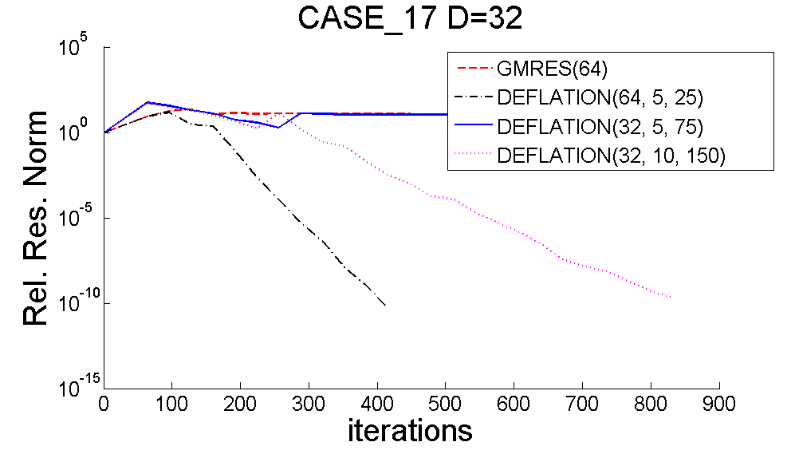
GPREMS(m) combined with deflation

Slide 44
Linear solvers for CFD problems
Summary
Gauss is efficient for small matrices
Static pivoting can fail but is very efficient
Gauss is scalable
AMG fails
GMRES(m) without preconditioner fails
GMRES(m) with ILU can fail
GMRES(m) with Additive or Multiplicative Schw arz converges
The number of iterations increases with the number of submatrices
two-level parallelism is promising
deflation is promising

